Slide 2
Automation fundamentals
Present: Thang Cao Tran
12/2018

Slide 3
OUTLINE
Introduction
Advantages & Disadvantages
Criteria Apply Test Automation
Automation Process
Framework/Test Tool
Test script design
Lessons learn in Automated testing
Notes:
3

Slide 4
introduction
Why use Automation.
Manual vs Automation Testing.
What’s Test Automation?
Notes:
4

Slide 5

Why use automation?
Our work everyday.
Frequent changes.
Frequent builds.
Regression test the same functionality for each build.
Frequent deliveries to customer.
Catch bugs early, we must test often.
Notes:
5

Slide 6
Manual vs automation testing
Manual Testing | Automation Testing
Test execution time ⬆ Test coverage ⬇ | Test execution time ⬇ Test coverage ⬆
Responsive and flexible | Relatively inflexible
Inconsistent | Very consistent
No maintenance needed | High maintenance needed
Low implementation cost | High implementation cost
High repetitive cost | Low cost in repetition, regression, etc.
Notes:
6

Slide 7
What’s test automation
Using of software to control the execution of tests.
Commonly, test automation involves automating a manual process currently in.
Test automation is a very important phase to save time and cost required for the testing cycles.
It is very important for the full testing of the product and it provides consistent and uniform results as well.
Notes:
7

Slide 8
Advantages & disadvantages
Key steps.
Benefits.
Advantages.
Disadvantages.
Limitations.
Which Test Cases should not automate?
Notes:
8

Slide 9
Key steps
Have testing knowledge.
Basic Test Automation.
Understand HTML, CSS, XPath, Web Development, Browsers.
Learn Add-ons: Firebug, FirePath, XPath Helper, Developer Tool.
Learn a Test Automation Tool: Katalon, HP QuickTest Professional, Jmeter….
Learn Java/Groovy/Python/C# or another programming language.
Learn Selenium in-depth
Notes:
9

Slide 10
Advantages
Run automated tests unattended (overnight).
Reliable, consistent testing.
Fast execution of checks and quick feedback.
Improves quality, increased test coverage.
Measure and document product quality.
Reduces costs and time for regression testing.
Optimizes Resources
Reusable.
Execution of test that can’t be done manually (Stress/Load/Performance Test … etc.)
Notes:
10

Slide 11
disadvantages
Script reliability depends on programmer.
Not reliable, automated checks can fail due to many factors.
Unstable for long test scenario.
Maintenance Time and Effort.
Find new bugs.
Complex analysis required.
Can not meet new features in the current sprint.
Notes:
11

Slide 12
limitation
It can't replace manual testing.
GUI friendliness, appearance and aesthetic consistency across the application.
Scope and limitation of the tool.
Cost of the Test tool.
Interact with application (Configuration, Memory, CPU … etc. )
Ad hoc/Random testing based on the knowledge of the application.
Notes:
12

Slide 13
Which tcs SHOULD not automate?
One –time testing.
ASAP testing. (We need to test NOW!)
Ad hoc/Random testing based on the knowledge of the application.
Test tool can not support.
Tests without predictable results.
Scheduling configuration.
Accessing back-end server that can impact to the whole system.
Notes:
Talking point:
Scheduling configuration: Complicated work flow ( ex: There are some jobs trigger event update, delete).
Accessing back-end server:
13

Slide 14
Criteria apply test automation
Customer requests.
Application should be stable.
Test that need to be run for every build of the application. (sanity check, regression test)
Tests that use multiple data values for the same actions. (data driven tests)
Test that require detailed information from application internals. (Memory, CPU)
Test that require considerable amount of time to perform manually.
Stress, load or performance testing.
Notes:
14

Slide 15
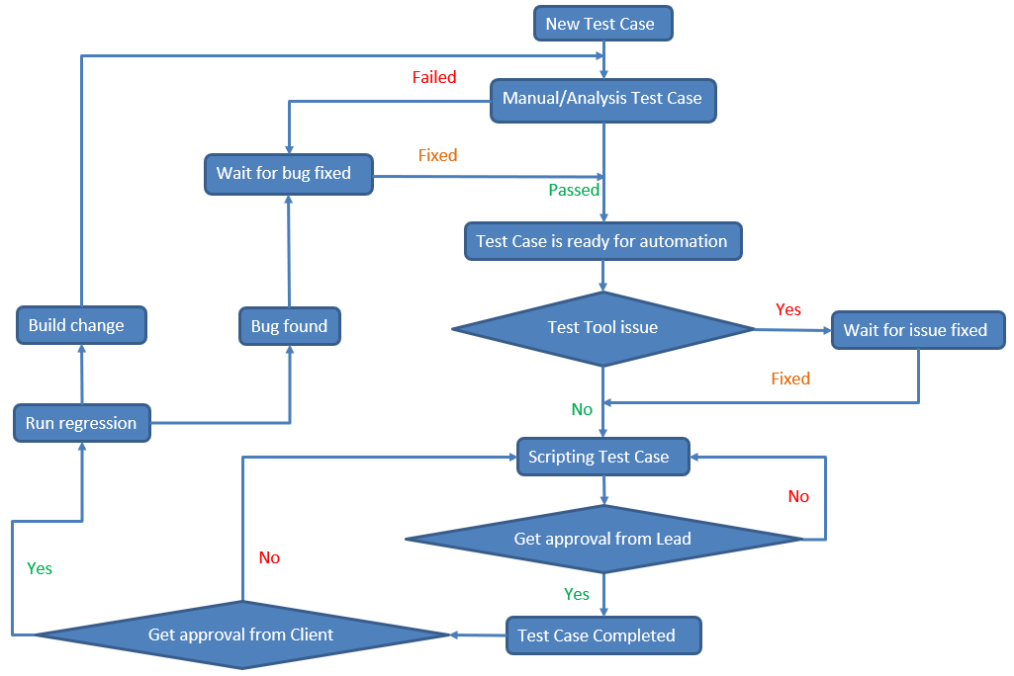
Automation process
Notes:
15

Slide 16
Framework/test tool
Test Suites
Test scripts
Test Suites
Test Data (XML, CSV, JSON, Variables, etc.
SUT
Inside Framework & Tool
Repository
Built-in Keywords, Functions
User-defined Keywords, Functions
Test Run, Test schedule
Test Reports
Email Notifications, Bug Reports
Notes:
16

Slide 17
Framework/test tool
Load Test Suites.
Execute test script list which defined in Test Suite.
Read Test Data to use for each test script.
Each test script use Built-n/User defined keywords to run test script.
Write log message and update test script results to Test Reports.
Notes:
17

Slide 18
Test cases design
Architecture.
Actions
Test script.
Types of test script.
When does define common action?
Notes:
18

Slide 19
architecture
Test Suites
TEST CASES
Test case 1 Test case 3 Test case …
Test case 2 Test case 4
Common
Test Cases
COMMON ACTIONS
Common
ComponentA
ComponentB
Component..
Function
Built-In
Built-In KWs
Custom KWs
click
setText
verify…
clickJS
waitFor
verify…
Notes:
19

Slide 20
actions
Built-in KW actions describe a single interaction between the user and the system under test. Provided by Test tool.
click, set text, selectOptionByValue, …. etc.
Custom KW actions describe a single interaction that Test tool is not supported, and are composed of several built-in actions.
clickAndWait, setTextOnCell, getListValuesAtColumn, … etc.
Common actions describe the business processes of the application.
login, send an email, verify an email, …, etc.
Notes:
20

Slide 21
test script
Read Data file (if have).
Pre-Condition.
Main Test Case.
Post-Condition
TIPs
+ Need to execute manual before implementing automate test script.
+ Test Case is well formatted, smooth running loop 3 times and should not be too long.
+ Should not use hard-code value in the test script. Should use Data File. Apply data driven if possible.
Notes:
21

Slide 22
TYPES OF TEST SCRIPT
Flow : Execute a scenario work flow on SUT. (without check points)
Get : Get information; operator … . It must return value.
Verify : must have least 1 Check Point (Passed/Failed)
TIPs
+ Common test script is named based on the function it’s supposed to do
+ Common test script name always start with a verb.
Syntax: Check/ Verify/ Create/ Load/ Save/ Does/ Get/ Select/ Set/… + object name/purpose
+ Parameter names should be easy to understand and without space. Parameter value ranges, if there is, should be clearly defined in the description.
Notes:
22

Slide 23
When does define COMMON action?
Utilities.
The workflow of the application.
Reused.
The Window (Edit/Verify)
The Window section (Edit/Verify)
The Dialog (Edit/Verify)
2 or more many Built-In actions.
Benefits : Reusability, maintainability, readability.
Notes:
23

Slide 24
Lessons learn in Automated testing
Design your tests first, before deciding which to automate
Do not mandate 100 percent automation
Do not automate a mess
Test automation is a software development process
Avoid complex logic in your test scripts
Beware of using automators who don’t understand testing and don’t respect testing
Testability is often a better investment than automation.
Notes:
24

Slide 25



Notes:
25

